Slide 2
EMRA Takes Care of You!
EMRA Is Your Community!
EMRA For A Lifetime!

Slide 3
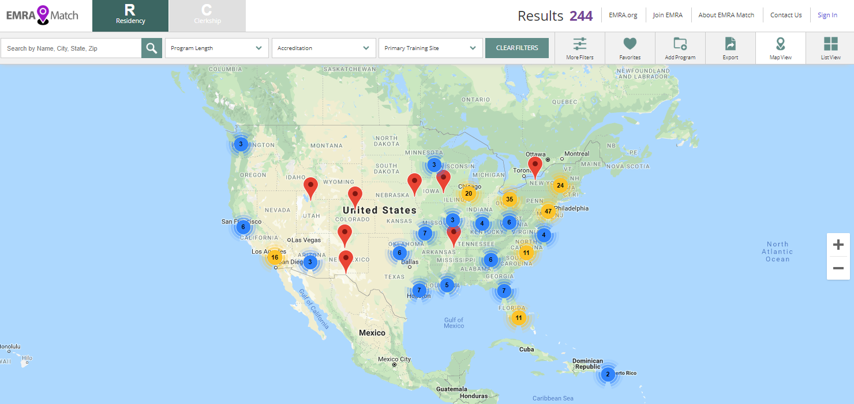
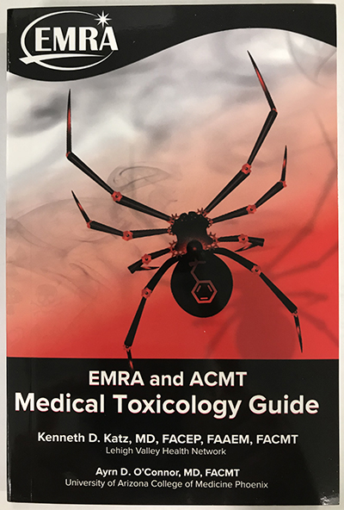
EMRA Takes Care of You
We strive to make you the best you can be in EM!
Bedside Resources
EM Resident
Podcasts & Vlogs
EMRA Match
EMRA Hangouts
Awards and Scholarships
Educational Events
Leadership Opportunities
Advocacy
Medical Student Council

Slide 4
EMRA Is Your Community
We connect you with your peers to help you accomplish your goals!
Networking
Mentorship
Advising
Friendships
add image or call out here

Slide 5
EMRA For A Lifetime
We tailor memberships for every stage of your journey!
Medical Students
Residents
Fellows
Alumni

Slide 6
20 EMRA COMMITTEES

Slide 7
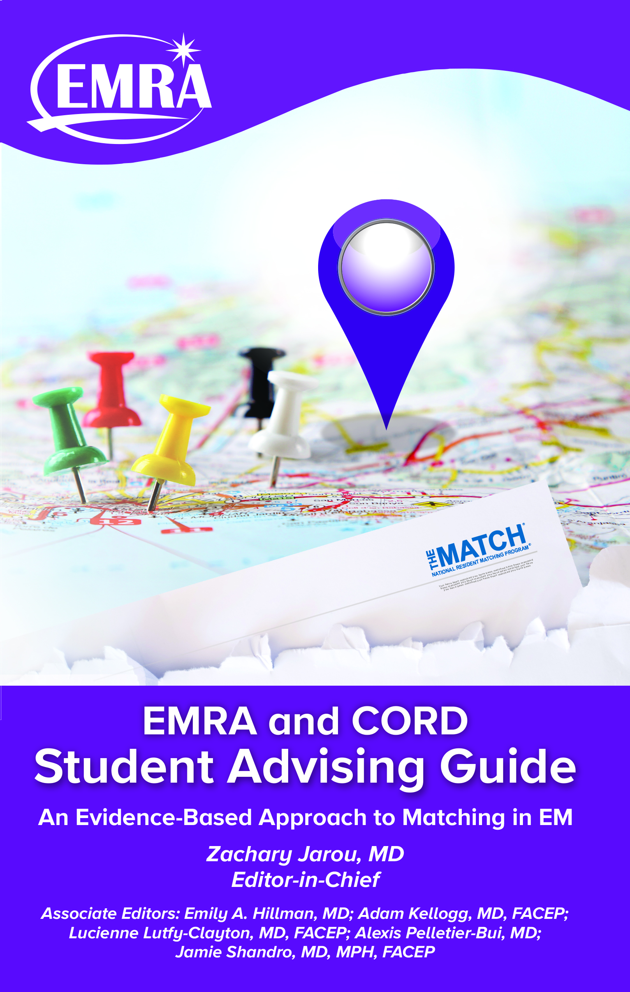
EMRA and CORD Student Advising Guide
An Evidence-based Approach to Matching in EM
Just a glimpse of the information you want and need!
Ch. 3
Third Year, and Planning for Fourth
When should I prepare for Step 2?
Is the Dean’s letter important for my residency?
When should I begin applying for away rotations?
When should I take Step 2?
Ch. 6
Crush Your Clerkship, Secure Your SLOEs
How to stand out and make a positive impression during your away rotation.
Proper patient presentation
Demystifying the SLOE
End-of-shift feedback and how to ask for it.
Ch. 8
Understanding Your Competitiveness
Difference between being competitive nationally, regionally and locally.
Most influential factors to increase my competitiveness for residency.
How many SLOEs do I need? Timing SLOEs.
Complementary with your membership!

